Slide 1
2 Corinthians 5:9– 6:13

Slide 2
⁹ So whether we are at home or away, we make it our aim to please him. ¹⁰ For we must all appear before the judgment seat of Christ, so that each one may receive what is due for what he has done in the body, whether good or evil.

Slide 3
¹¹ Therefore, knowing the fear of the Lord, we persuade others. But what we are is known to God, and I hope it is known also to your conscience. ¹² We are not commending ourselves to you again but giving you cause to boast about us, so that you may be able to answer those who boast about outward appearance and not about what is in the heart. ¹³ For if we are beside ourselves, it is for God; if we are in our right mind, it is for you. ¹⁴ For the love of Christ controls us, because we have concluded this: that one has died for all, therefore all have died; ¹⁵ and he died for all, that those who live might no longer live for themselves but for him who for their sake died and was raised.

Slide 4
¹⁶ From now on, therefore, we regard no one according to the flesh. Even though we once regarded Christ according to the flesh, we regard him thus no longer. ¹⁷ Therefore, if anyone is in Christ, he is a new creation. The old has passed away; behold, the new has come. ¹⁸ All this is from God, who through Christ reconciled us to himself and gave us the ministry of reconciliation; ¹⁹ that is, in Christ God was reconciling the world to himself, not counting their trespasses against them, and entrusting to us the message of reconciliation. ²⁰ Therefore, we are ambassadors for Christ, God making his appeal through us. We implore you on behalf of Christ, be reconciled to God. ²¹ For our sake he made him to be sin who knew no sin, so that in him we might become the righteousness of God.

Slide 5
6 Working together with him, then, we appeal to you not to receive the grace of God in vain. ² For he says,
“In a favourable time I listened to you,
and in a day of salvation I have helped you.”
Behold, now is the favourable time; behold, now is the day of salvation.

Slide 6
³ We put no obstacle in anyone’s way, so that no fault may be found with our ministry, ⁴ but as servants of God we commend ourselves in every way: by great endurance, in afflictions, hardships, calamities, ⁵ beatings, imprisonments, riots, labours, sleepless nights, hunger; ⁶ by purity, knowledge, patience, kindness, the Holy Spirit, genuine love; ⁷ by truthful speech, and the power of God; with the weapons of righteousness for the right hand and for the left; ⁸ through honour and dishonour, through slander and praise. We are treated as impostors, and yet are true; ⁹ as unknown, and yet well known; as dying, and behold, we live; as punished, and yet not killed; ¹⁰ as sorrowful, yet always rejoicing; as poor, yet making many rich; as having nothing, yet possessing everything.

Slide 7
¹¹ We have spoken freely to you, Corinthians; our heart is wide open. ¹² You are not restricted by us, but you are restricted in your own affections. ¹³ In return (I speak as to children) widen your hearts also.

Slide 8
¹⁷ Therefore, if anyone is in Christ, he is a new creation. The old has passed away; behold, the new has come. ¹⁸ All this is from God, who through Christ reconciled us to himself
^{5:21} For our sake he made him to be sin who knew no sin, so that in him we might become the righteousness of God.
This Photo by Unknown Author is licensed under CC BY-ND

Slide 9
Paul is defending his ministry – His conduct and the message he preaches
Showing us what we should look for in a servant of God
False teachers are more common than we like to think. And draw many followers.
Sometimes we’re impressed by the wrong stuff.
To recognise a genuine servant of God / leader in the church, we are told to judge.
The outward ‘show’ isn’t what matters. Look at the heart.
¹² We are not commending ourselves to you again but giving you cause to boast about us, so that you may be able to answer those who boast about outward appearance and not about what is in the heart.
^{1 Samuel 16:7} But the Lord said to Samuel, “Do not look on his appearance or on the height of his stature, because I have rejected him. For the Lord sees not as man sees: man looks on the outward appearance, but the Lord looks on the heart.”
This Photo by Unknown Author is licensed under CC BY-ND

Slide 10
Paul is defending his ministry – His conduct and the message he preaches
Showing us what we should look for in a servant of God
False teachers are more common than we like to think. And draw many followers.
Sometimes we’re impressed by the wrong stuff.
To recognise a genuine servant of God / leader in the church, we are told to judge.
The outward ‘show’ isn’t what matters. Look at the heart.
1. What’s the motivation?
Aimed to please God
Feared the Lord;
Controlled by the love of Christ;
Lived for Christ;
Lived righteously
Preached Reconciliation
Preached Righteousness
Paul was defending his ministry so that the Corinthian Church would recognise he was genuine, and therefore trust his teaching and stop falling for false teachers.
³ We put no obstacle in anyone’s way, so that no fault may be found with our ministry,
One of the biggest obstacles to people coming to faith in Jesus Christ, is when Ministers of God behave badly.
This Photo by Unknown Author is licensed under CC BY-ND

Slide 11
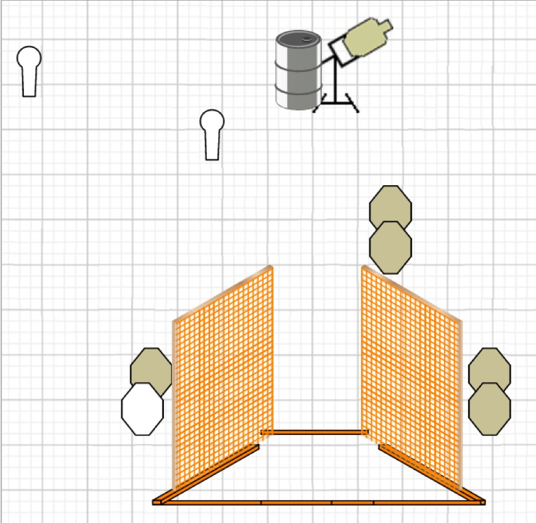
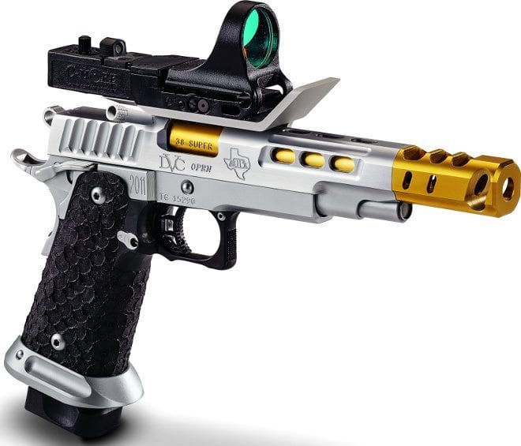
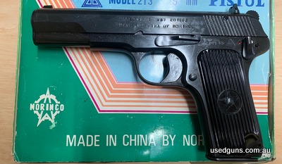

Slide 12
Paul is defending his ministry – His conduct and the message he preaches
Showing us what we should look for in a servant of God
Look at the heart.
Sometimes we’re impressed by the wrong stuff.
1. What’s the motivation?
Aimed to please God
2. What’s the behaviour? Bad behaviour by church leaders, is a stumbling block
Commended
True Servants of God Must:
By:
Great endurance
purity / holiness
knowledge
patience;
kindness;
the Holy Spirit;
genuine love;
truthful speech;
the power of God
Not a ‘piker’. Don’t give up when the going gets tough
Be holy and pure in speech, and behaviour
Know and teach the true Gospel
Be long suffering (put up with a lot without retaliating)
Display kindness; goodness; friendliness
Be filled with Holy Spirit (evidenced by a transformed life)
Not ‘play act’ when it comes to love. Be loving – not flattering
Always tell the truth. Even if it isn’t what people want to hear
Minister in the Power of God – not ‘slick shows’ or ‘spin’
With:
weapons of righteousness for the right hand and for the left
Through:
honour and dishonour; slander and praise
Treated:
This Photo by Unknown Author is licensed under CC BY-ND

Slide 13
Sometimes we’re impressed by the wrong stuff.
Commended
True Servants of God Must:
By:
Great endurance
purity / holiness
knowledge
patience;
kindness;
the Holy Spirit;
genuine love;
truthful speech;
the power of God
Not a ‘piker’. Don’t give up when the going gets tough
Be holy and pure in speech, and behaviour
Know and teach the true Gospel
Be long suffering (put up with a lot without retaliating)
Display kindness; goodness; friendliness
Be filled with Holy Spirit (evidenced by a transformed life)
Not ‘play act’ when it comes to love. Be loving – not flattering
Always tell the truth. Even if it isn’t what people want to hear
Minister in the Power of God – not ‘slick shows’ or ‘spin’
With:
weapons of righteousness for the right hand and for the left
Through:
honour and dishonour; slander and praise
Treated:
as sorrowful, yet always rejoicing;
as poor, yet making many rich;
as having nothing, yet possessing everything.
as imposters, yet true;
as unknown and yet well known;
as dying and behold, we live;
as punished and yet not killed;
This Photo by Unknown Author is licensed under CC BY-ND

